Slide 1
Impact of interfractional anatomic variations on breath-hold SBRT for pancreatic cancer: Are we flying blind with cone-beam CT image guidance?
COMP-CWS 2021
Josh Niedzielski, PhD
Chief Resident, Dept of Radiation Physics
MD Anderson Cancer Center

Slide 2
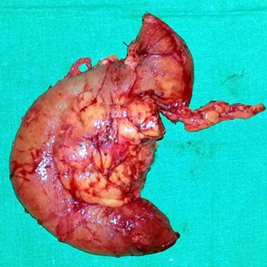
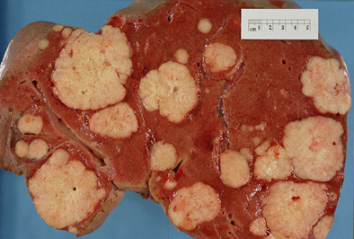
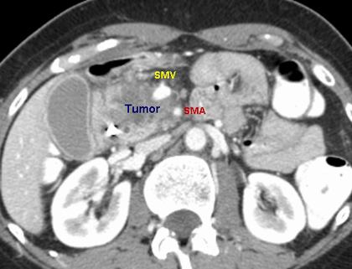
Pancreatic Cancer
Resectable
Surgery (10-20%)
Staging
Resectable
Borderline resectable
Locally advanced
Metastatic
Chemotherapy (40-50%)
Metastatic
BR/LA Disease
???
(30-40%)
Slide adapted from Gabriel Sawakuchi, PhD

Slide 3
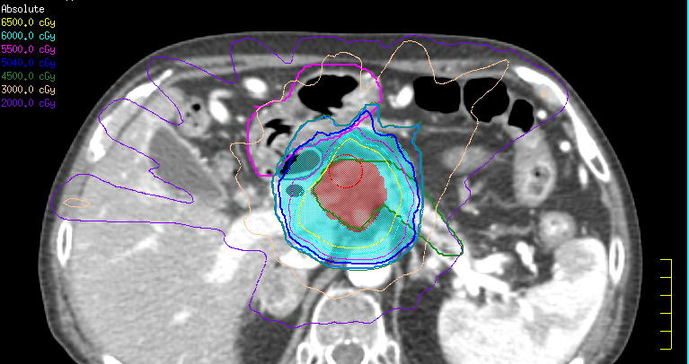
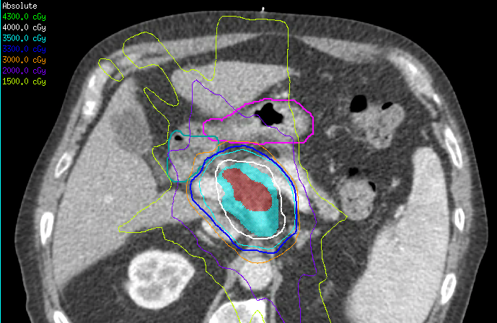
Stereotactic Body Radiation Therapy
Conv RT
Benefits:
Highly conformal dose distributions
Shorten overall Tx length
Higher biological effective dose (BED)
Requirements:
High dose gradients
Image guidance
Immobilization
Motion management
SBRT

Slide 4
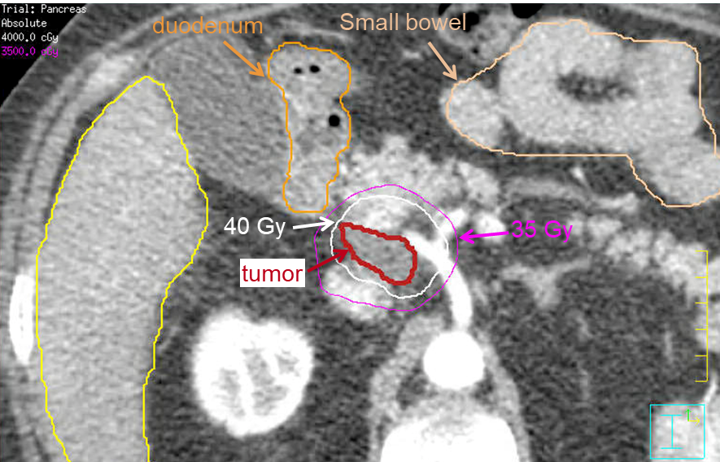
SBRT for Pancreatic Cancer
Conundrum:
Pancreas tumors require high RT doses
Several OARs are very close to pancreas
Duodenum, stomach, & small bowel
GI OARs are highly radiosensitive
Volume receiving 35 Gy < 1 cm³
Figure courtesy of Gabriel Sawakuchi, PhD

Slide 5
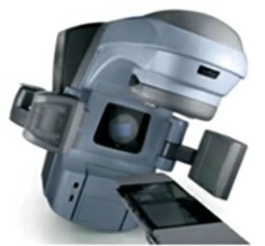
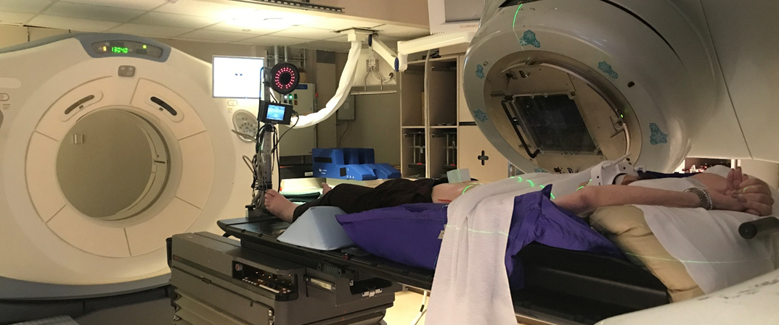
Study overview
Motivation
Pancreas Ca Tx has poor outcomes
GI Anatomy/tumor can have significant interfractional motion
SBRT could potentially be efficacious
For pancreas SBRT, most centers use CBCT image guidance
Figure adapted from Srinivasan et al. 2014 (Pol J Radiol)
Notes:
-

Slide 6
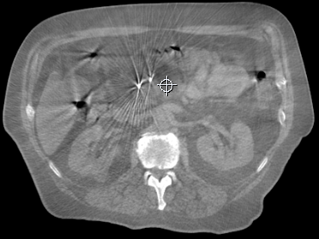
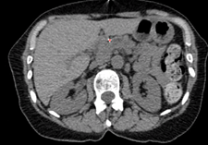
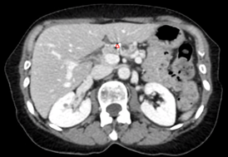
Study overview
Concerns/Issues
CBCT is not diagnostic quality
Reliance on implanted fiducials for alignments
OARs can be indiscernible on daily CBCTs
Unresolved questions
How does interfractional motion impact OAR/tumor dose
What is the daily fractional dose variations?
How does this differ from plan dose?
Study Aim
Determine dosimetric differences between planned and fractional accumulated doses to the GTV/OARs due to interactional anatomic variations
CBCT
CTOR
Plan

Slide 7
Methods
Cohort
11 pancreas cancer patients
5-Fx SBRT
Breath-hold motion management
Several Rx’s
33, 36, 40 Gy
3-5 implanted gold fiducials for tumor localization
Daily in-room CT-on-rails (CTOR) image guidance

Slide 8
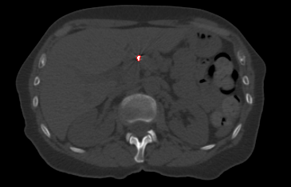
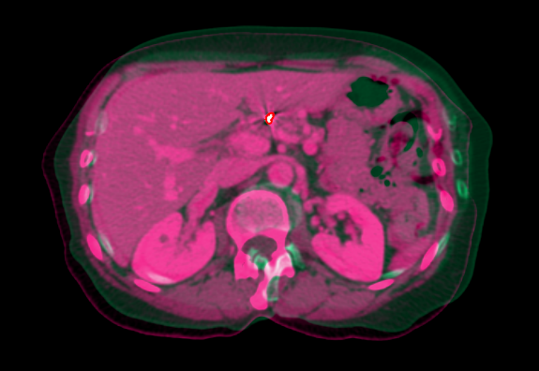
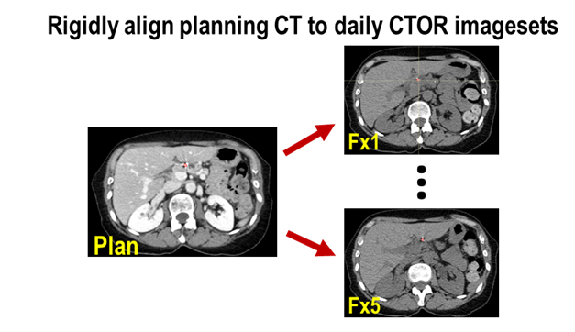
Methods
How do we get dose?
CT-on-rails is key!
Delineate Fiducials
Bone window
Ensure consistency
Simulated CBCT alignment
Alignment in Raystation
Rigid, translational only
Mimic table shifts on Tx couch

Slide 9
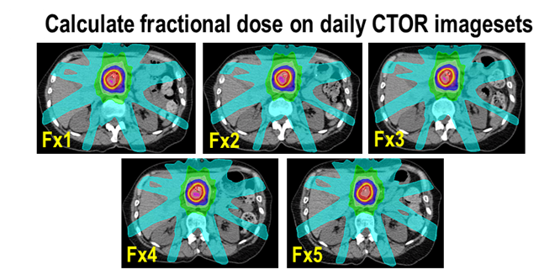
Methods
Calculate fractional doses
Use CTOR data to calculate daily Tx doses
Delineate duodenum, stomach, small bowel, GTV on each CTOR imageset
Accumulate fractional doses to final accumulated DVH
OAR DVH metrics: D0.1cc, D1.0cc, D3.0cc, D9.0cc
GTV DVH metrics: D100%, D98%, D95%, D90%

Slide 10
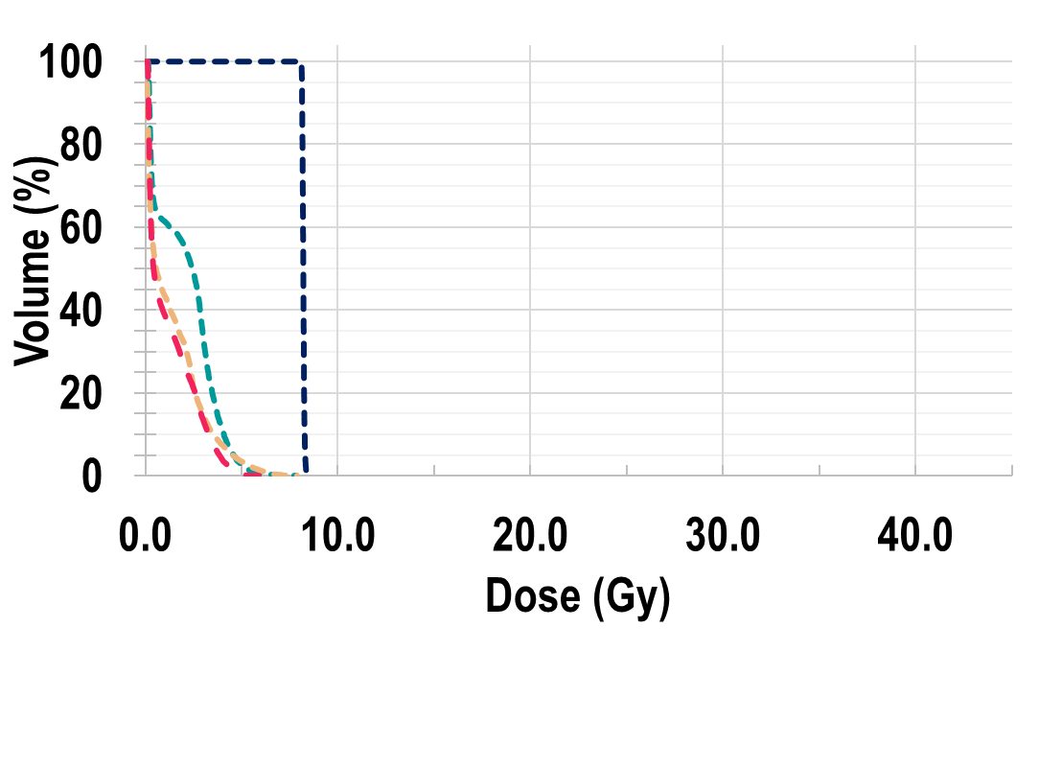
Methods
Dose Accumulation
Compute fractional absolute DVHs
Sum fractional DVHs into accumulate DVH
Extract fractional & total accumulated DVH metrics
Fraction 1

Slide 11
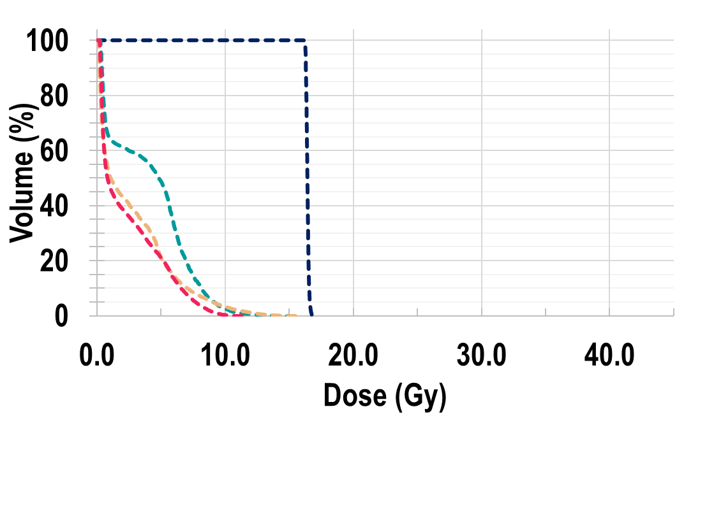
Methods
Dose Accumulation
Compute fractional absolute DVHs
Sum fractional DVHs into accumulate DVH
Extract fractional & total accumulated DVH metrics
Fraction 1
Fraction 1+2
…

Slide 12
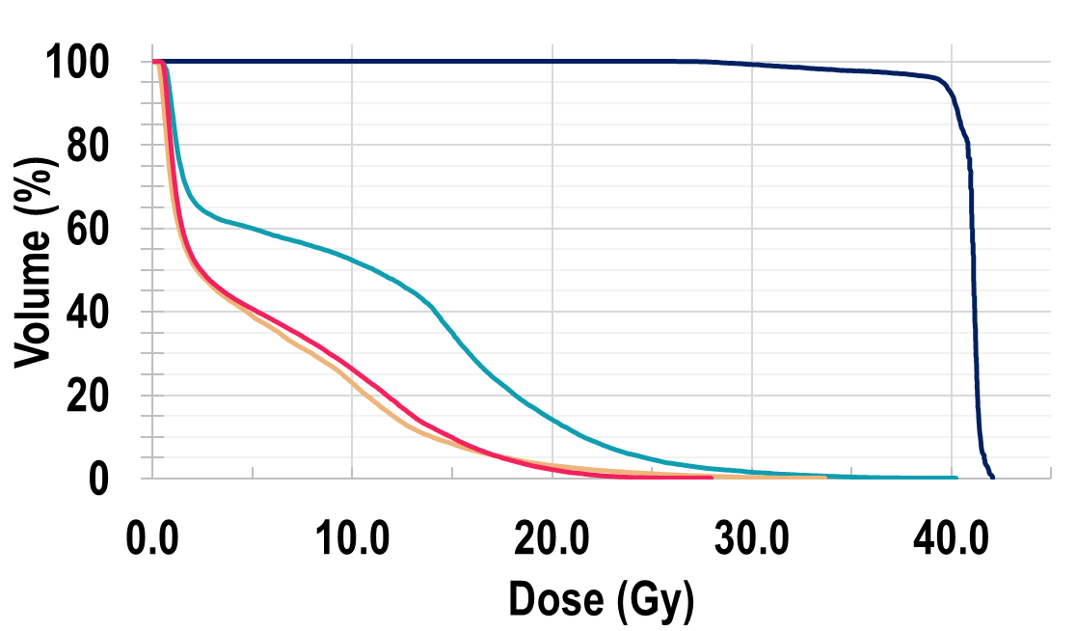
Methods
Dose Accumulation
Compute fractional absolute DVHs
Sum fractional DVHs into accumulate DVH
Extract fractional & total accumulated DVH metrics
Accumulated DVH
Fraction 1
Fraction 1+2
…

Slide 13
Methods
Analysis
Daily fractional variations in OAR/GTV dose
Planned vs. Accumulated dose
Violations in OAR constraint?
D1.0cc < 35 Gy
Loss of GTV coverage?
D100%
Examine fractional variations in dose
Examine total planned vs. accumulated dose

Slide 14
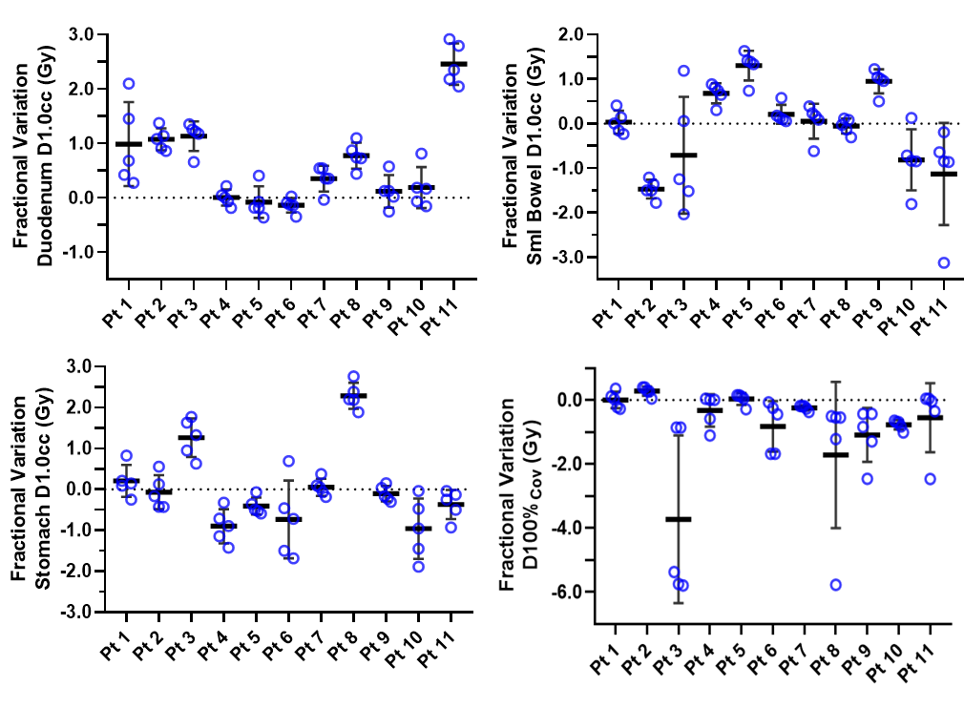
Results
Interfractional daily dose variations
Mean absolute fractional difference in dose metrics b/w planned and accumulated
Compare 1/5th of total planned dose to each fractional dose
Large variance in OAR fractional doses were found for most patients
Lost in GTV coverage was also found on some fractions for a few patients
Niedzielski et al. 2020 Red Journal [Submitted 12/2020]

Slide 15
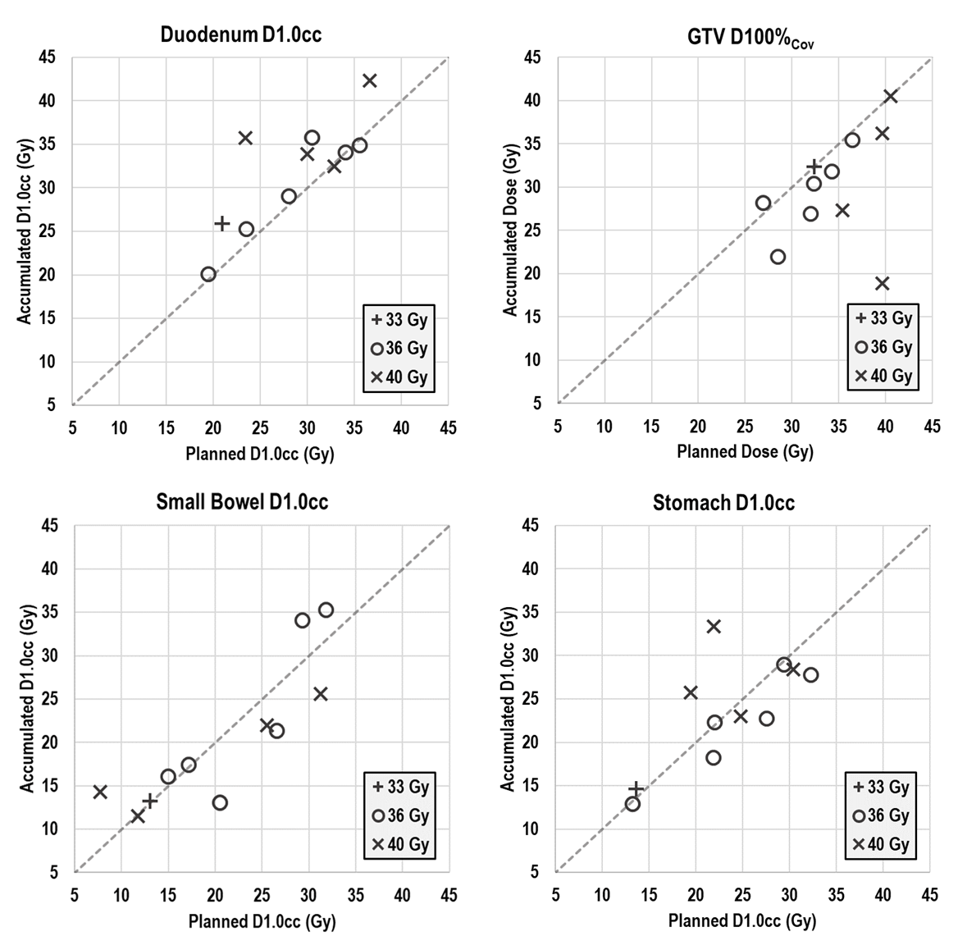
Results
Interfractional dose variations (total dose)
Total dose differences b/w planned and accumulated DVH metrics
3 patients violated D1.0cc <35 Gy on accumulated dose, but not plan
2 duodenum, 1 small bowel
OAR dose differences less pronounced for large volumes analyzed
Niedzielski et al. 2020 Red Journal [In preparation]

Slide 16
Conclusions
Interfractional dose variations are considerable
On daily fractional basis
Total dose distribution
Total planned vs. accumulated dose differences:
Can result in patients violating OAR constraints
Loss of target coverage
Caution on assuming dose distribution when using CBCT image guidance

Slide 17
Acknowledgements
Thank you!
Email: jsniedzielski@mdanderson.org
GI Radiation Physics:
Gabriel Sawakuchi, PhD (mentor)
Sam Beddar, PhD
Rachael Martin, PhD
Luis Perles, PhD
Others:
Neal Rebueno, CMD
Joseph M. Herman, MD, MSc
Sylvia S. W. Ng, MD, PhD
Laurence Court, PhD
Carlos Cardenas, PhD
GI Radiation Oncology:
Albert Koong, MD, PhD
Yufei Liu, MD
Prajnan Das, MD, MS
Ethan B. Ludmir, MD
Eugene J. Koay, MD, PhD
Cullen Taniguchi, MD, PhD
Emma B. Holliday, MD
Grace L. Smith, MD, PhD
Bruce D. Minsky, MD

