Slide 1
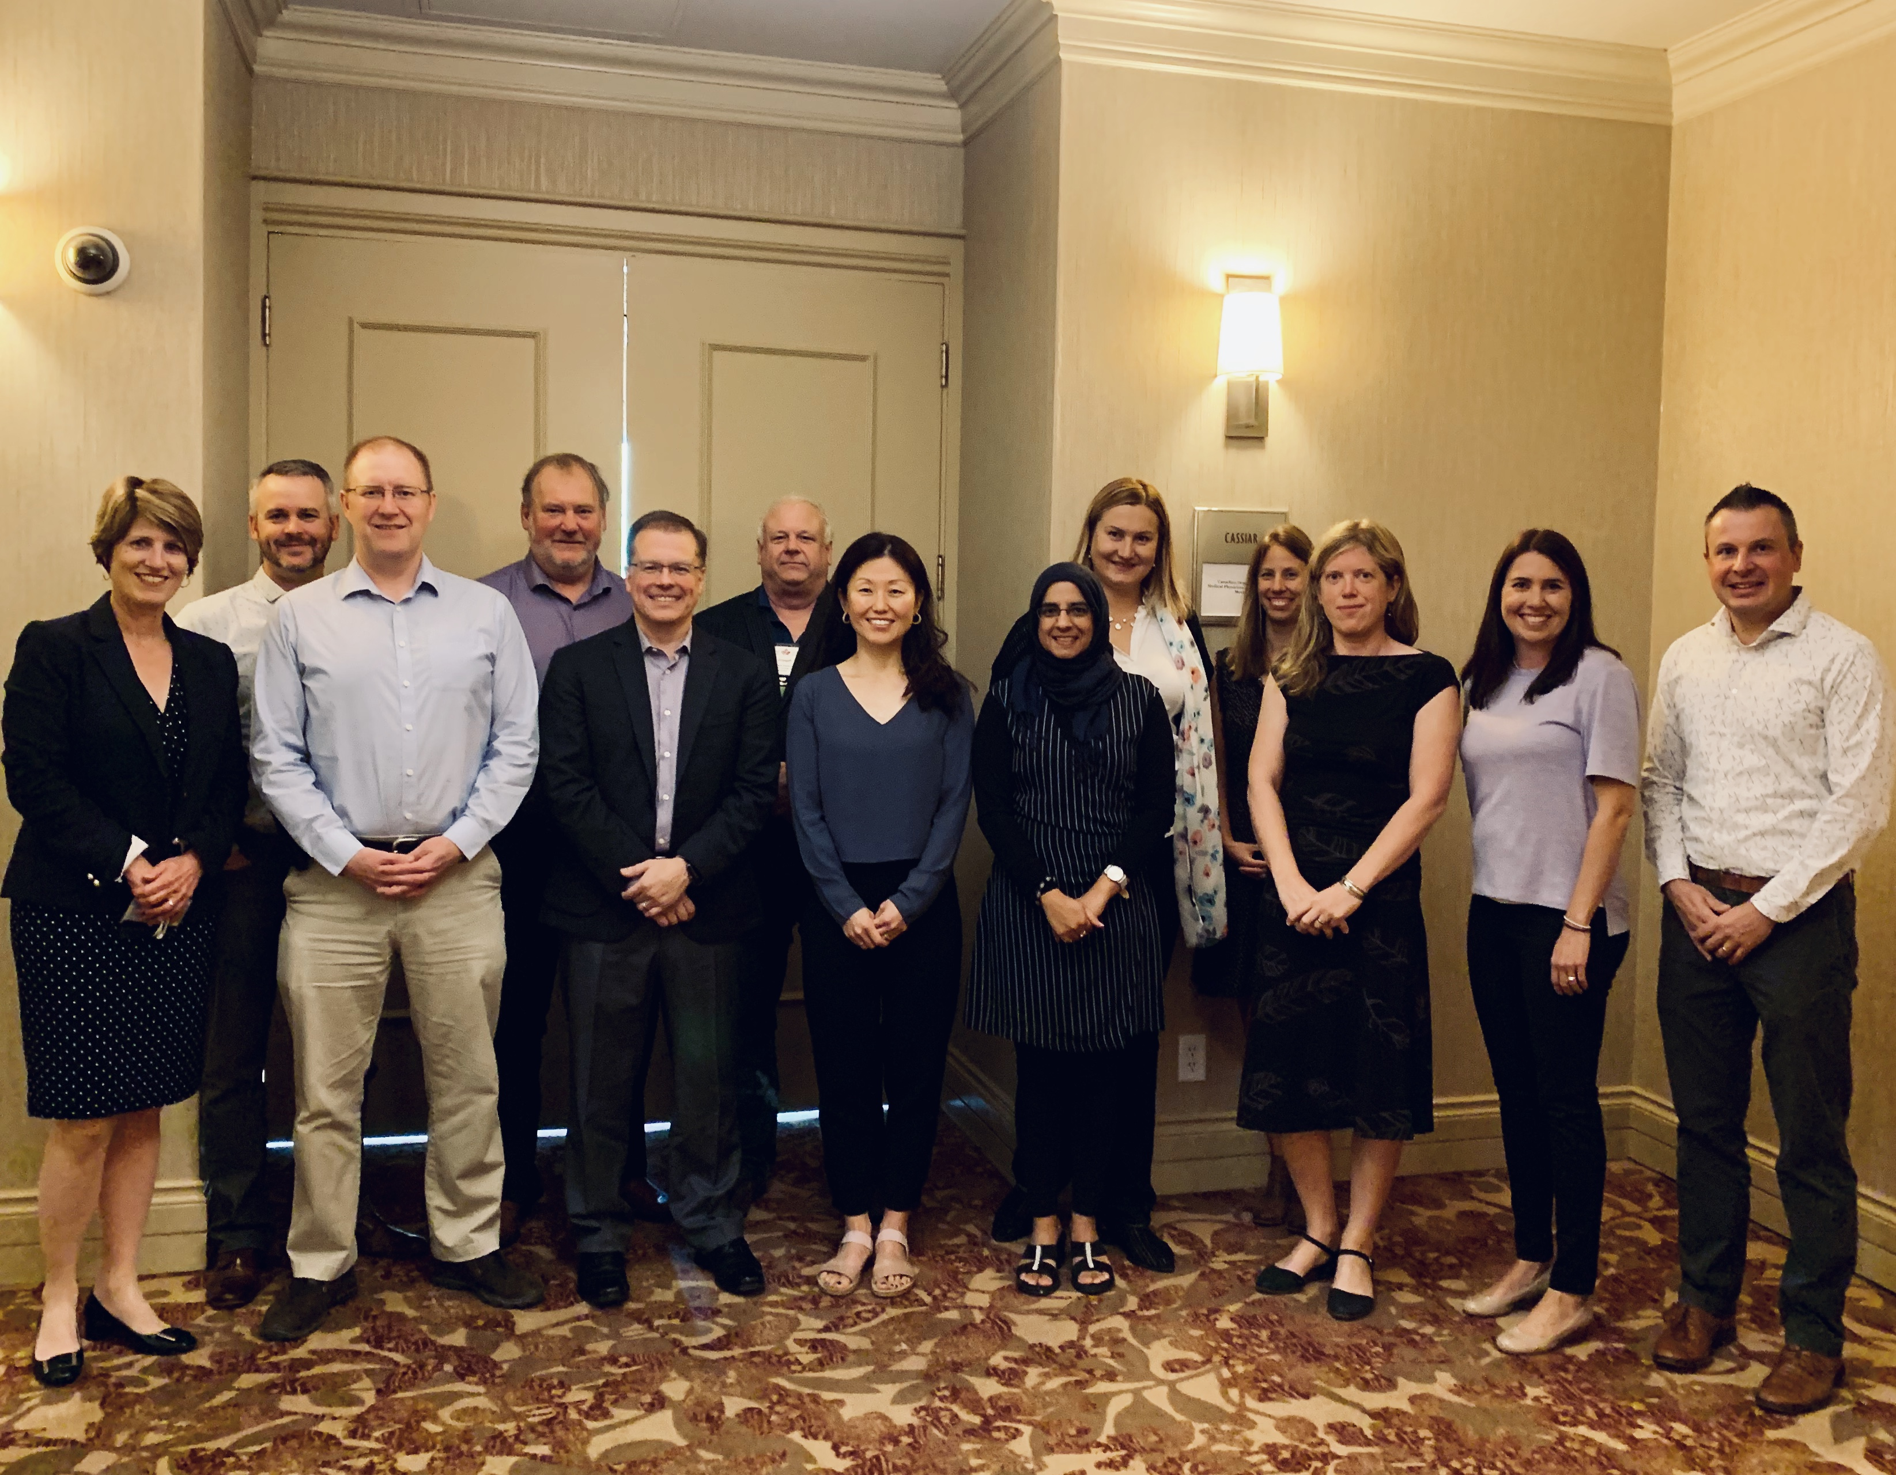
About

Slide 2
Medical Physics
The application of physics concepts, theories and methods to medicine or healthcare

Slide 3
Medical Physicists
Health care professionals with specialized training in the medical applications of physics.
Specialized in radiation physics, ultrasound, magnetic and electric fields, infra-red and ultraviolet light, heat and lasers in diagnosis and therapy

Slide 4
What medical physicists do
Clinical Service
Radiation Safety
Research and Development
Teaching

Slide 5
Career steps
Undergrad degree in STEM
PhD (or MSc) in medical physics
CAMPEP accredited preferable
Medical physics clinical residency (2 years)
CCPM (Canadian College of Physicists in Medicine) certification

Slide 6
STRATEGIC PLAN
COMP’s Vision
To be the recognized leader and primary resource for medical physics in Canada
COMP’s Mission
To champion medical physicists' leadership in patient care through education, innovation, and advocacy.
Strategic Priority 1- Advocate for medical physicists as leaders in innovation and technology implementation in health care.
Strategic Priority 2- Ensure medical physicists in Canada can create and have access to relevant scientific and professional content.
Strategic Priority 3- Connect the entire Canadian medical physics community: to each other, to COMP, to other professionals, and to resources.
Strategic Priority 4- Engage in strategically aligned international initiatives.

Slide 7
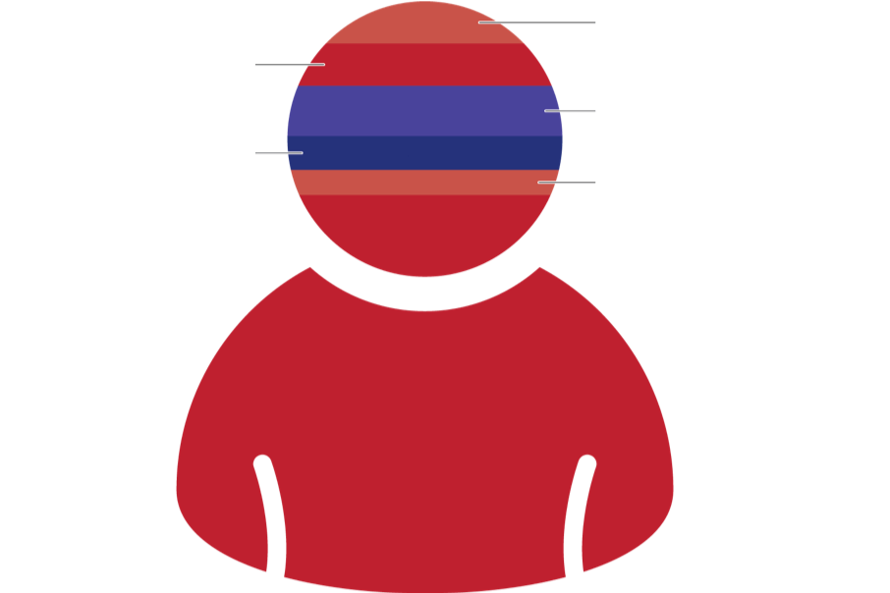
WHAT WE DO
4%
Magnetic resonance imaging (18)
Mammography physics (29)
6%
8%
Diagnostic radiology physics (38)
Nuclear medicine physics (18)
4%
1.5%
Medical health physics (7)
Radiation oncology physics (399)
Data from 2018 professional survey (461 respondents)
87%

Slide 8
WHERE WE WORK
Results from 439 respondents in the 2018 professional survey.
51%
51%
7%
29%
Hospital
(226)
Cancer Centre
(223)
University, Government,
Research Institute (127)
Industry / private company
(29)

Slide 9
COMP MEMBERSHIP BY GENDER
 | Female | Male
All Members | 29% | 71%
Trainees | 41% | 59%
Retired | 16% | 84%

Slide 10
COMP MEMBERSHIP
+20 Corporate members!
Total Membership: 809

Slide 11
IT TAKES AN ARMY
23% of the membership is involved in volunteering with COMP, there are many roles to take, consider getting involved today! (approx. 186 Members are engaged in volunteering)

Slide 12
COMP COMMITTEES
BOARD
Communication
Imaging
QARSAC
Awards & Nominations
Professional Affairs
Science
Education
ASM
Winter School
CNSC Working Group
Women’s Committee
Student Council
COMP History

